Slide 1
The Distance Formula
Lesson 9.5

Slide 2
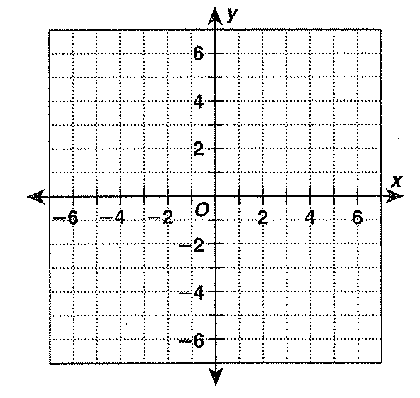
Find the distance between the two points:
(4, 4) and (-6, 4)
(-2, 6) and (-2, -5)
(4, 6) and (-5, -3)
9
9
Count between 4 and -6.
Distance is 10 units.
Count between 6 and -5.
Distance is 11 units.
Draw in a right Δ.
Use the Pythagorean Theorem to solve.
9² + 9² = c²
162 = c²
= c

Slide 3
Theorem 71:
If P = (x₁, y₁) and Q = (x₂, y₂) are any two points, then the distance between them can be found with the formula
PQ
or
Leave answer in lowest terms – reduce radical.

Slide 4
Find the distance between A (11, 10) and B (3, 7).
2
2

Slide 5
Mid-Point of a line.
Midpoint =
Find the mid-point of line AB when A is (11, 10) and B is (3, 7).

Slide 6
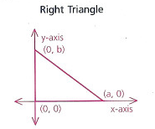
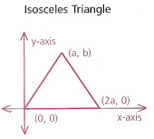
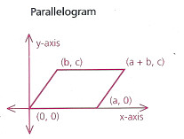
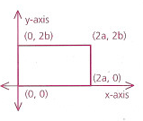
Identifying Shapes with Coordinates
Rectangle

Slide 7
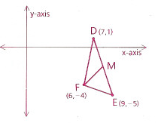
If D = (7, 1), E = (9, -5) and F = (6, 04), find the length of the median from F to DE.
Find the midpoint M of DE.
(8, -2)
Use the distance formula to find FM.
FM =

