Slide 1
NOTES 5.4
FOUR-SIDED POLYGONS

Slide 2
Polygons:
Plane figures
Many sided figures
Straight line segments
Consecutive sides intersect at endpoints
Each vertex belongs to only two sides

Slide 3
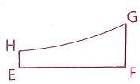
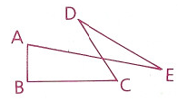
Is this a polygon?
1.
1. EFGH is not a polygon because it is not entirely made up of straight segments.
2.
2. ABCDE is not a polygon because nonconsecutive sides do not intersect.

Slide 4
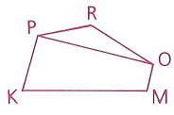
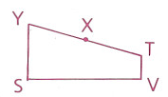
Is this a polygon?
3.
3. PKMO, PKMOR and POR are polygons but PKMOPRO is not because each vertex must belong to exactly two sides.
4.
4. SVTY is a polygon but SVTXY is not because consecutive sides must be noncollinear.

Slide 5
Is this a polygon?
5. PLAN is not a polygon because it is an open figure.
5.
6.
6. Yes, these are all polygons.

Slide 6
Name polygons by their sides, either clockwise or counter clock wise.
Convex Polygons: A polygon in which each interior angle has a measure less than 180 degrees.
no
yes

Slide 7
Diagonals: a diagonal of a polygon is any segment that connects two non-consecutive (nonadjacent) vertices of a polygon.

Slide 8
Quadrilaterals: 4 sided polygons.
Parallelogram: both pairs of opposite sides are parallel
Rectangle: a parallelogram with at least one right angle
Rhombus: a parallelogram with at least two consecutive sides are congruent
Kite: two disjointed pairs of consecutive sides are congruent
Square: parallelogram that is a rectangle and a rhombus

Slide 9
Trapezoid: a quadrilateral with exactly one pair of parallel sides. Parallel sides are called the bases of the trapezoid.
Isosceles trapezoid: trapezoid in which non-parallel sides (legs) are congruent. Base angles are lower and upper base angles.

